Slide 1
Python project
SUBJECT CODE -- 20ECP-118_20IS-BD_B
Secret
Messages
using python
(CRPYTOGRAPHY)

Slide 2


Team 3
PARMEET SINGH
AKASH
BHARTI MALIK
HARSH BABU
ASHISH KUMAR
(20BCS4415)
(20BCS4388)
(20BCS4384)
(20BCS4412)
(20BCS4409)

Slide 3
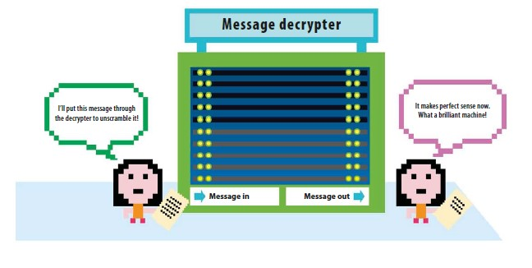



Agenda
History
Why cryptography ?
Solutions using Python
Applications
Coding
Summary

Slide 4
Cryptography
The word cryptography comes from the ancient Greek words for “hidden” and “writing.” People have been using this technique to send secret messages for nearly 4,000 years.

Slide 5
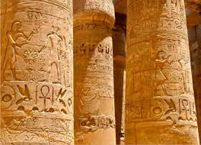
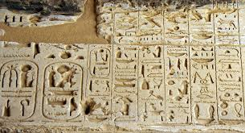
History

Slide 6
1932: Polish cryptographer Marian Rejewski discovers how Enigma works. Cryptographers like Alan Turnig to figure out how to crack the key, which changes daily. It proves crucial to the Allies' World War II victory. You can read more about the Bombe Machine designed by Turing and created by the British Tabulating Machine Company.

Slide 7
1945: Claude E. Shannon of Bell Labs publishes an article called "A mathematical theory of cryptography." It's the starting point of modern cryptography.

Slide 8
1970-73: IBM forms a 'crypto group,' which designs a block cipher to protect its customers' data. In 1973, the US adopted it as a national standard - the Data Encryption Standard, or DES. It remains in use until it cracked in 1997. 2000: the Advanced Encryption Standard replaces DES, or AES, found through a competition open to the public. Today, AES is available royalty-free worldwide and is approved for use in classified US government information.

Slide 9
Today: As more and more services move to the cloud, encrypting data in transit is crucial, and cryptographers are continually developing and refining solutions to this challenge

Slide 10

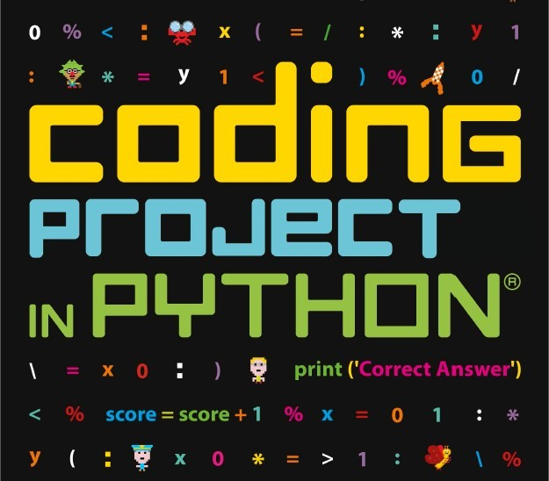
CRPYTOGGRAPHY
WHY & PURPOSE

Slide 11
Why & Purpose Cryptography ?
Authentication: The process of proving one's identity. (The primary forms of host-to-host authentication on the Internet today are name-based or address-based, both of which are notoriously weak.) Privacy/confidentiality: Ensuring that no one can read the message except the intended receiver. Integrity: Assuring the receiver that the received message has not been altered in any way from the original. Non-repudiation: A mechanism to prove that the sender really sent this message.

Slide 12


Cryptography using PYTHON
IDLE

Slide 13
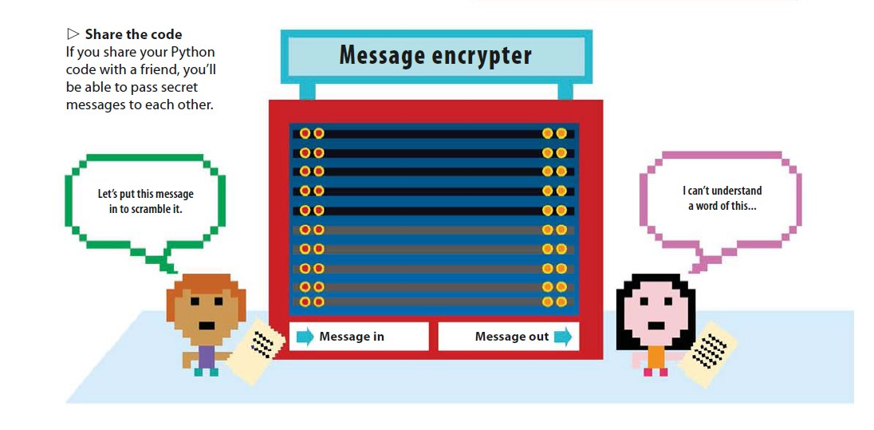
AIM
Encryption software is software that uses the cryptography to prevent unauthorized access, interpretation to a analog or digital information or data
Cryptography protects data , information on computers as well as the information sent to other computers

Slide 14
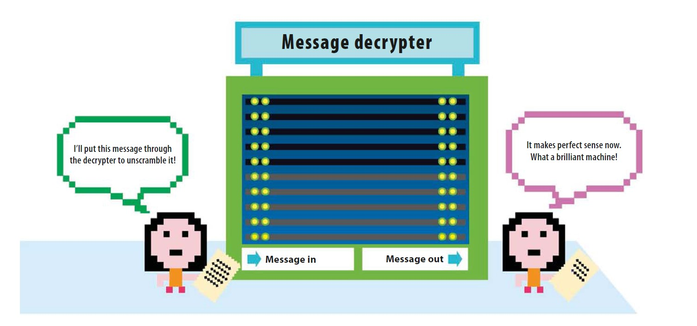
HOW IT WORKS ??
The program rearranges the order of letters in the message so that it can’t be understood. It does this by working out which letters are in even or odd positions. Then it swaps the position of each pair of letters in the message, starting with the first two, then the next two, and so on. The program also makes encrypted messages readable again by switching the letters back to where they started.

Slide 15
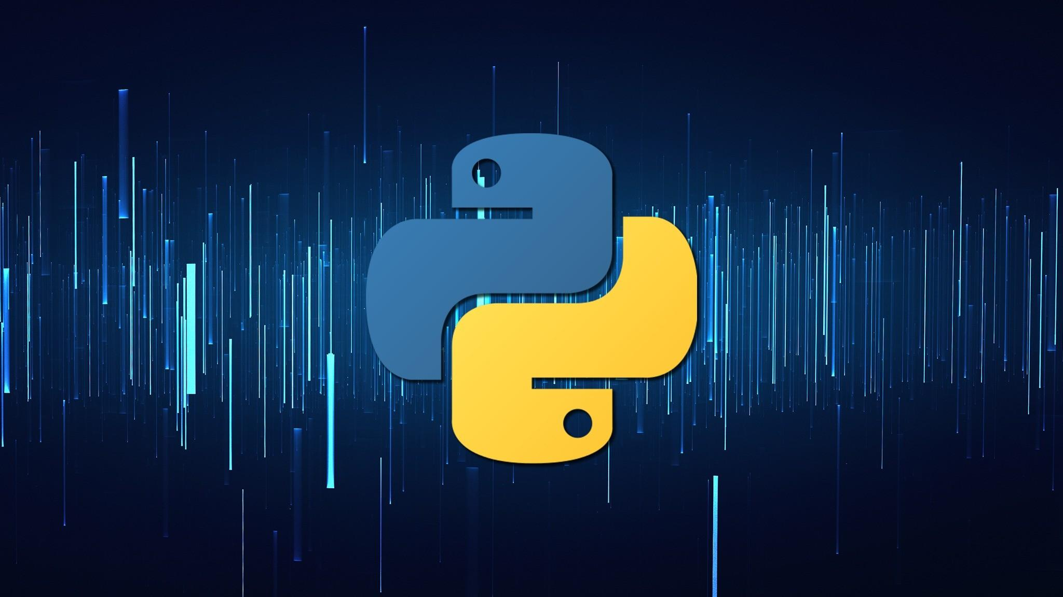
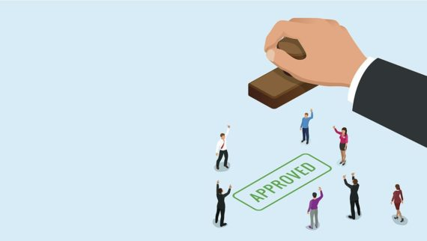
Software : PYTHON
MODULES :
RANDOM
ONETIMEPAD
NUMPY
STRING
MATH
PYOTP

Slide 16
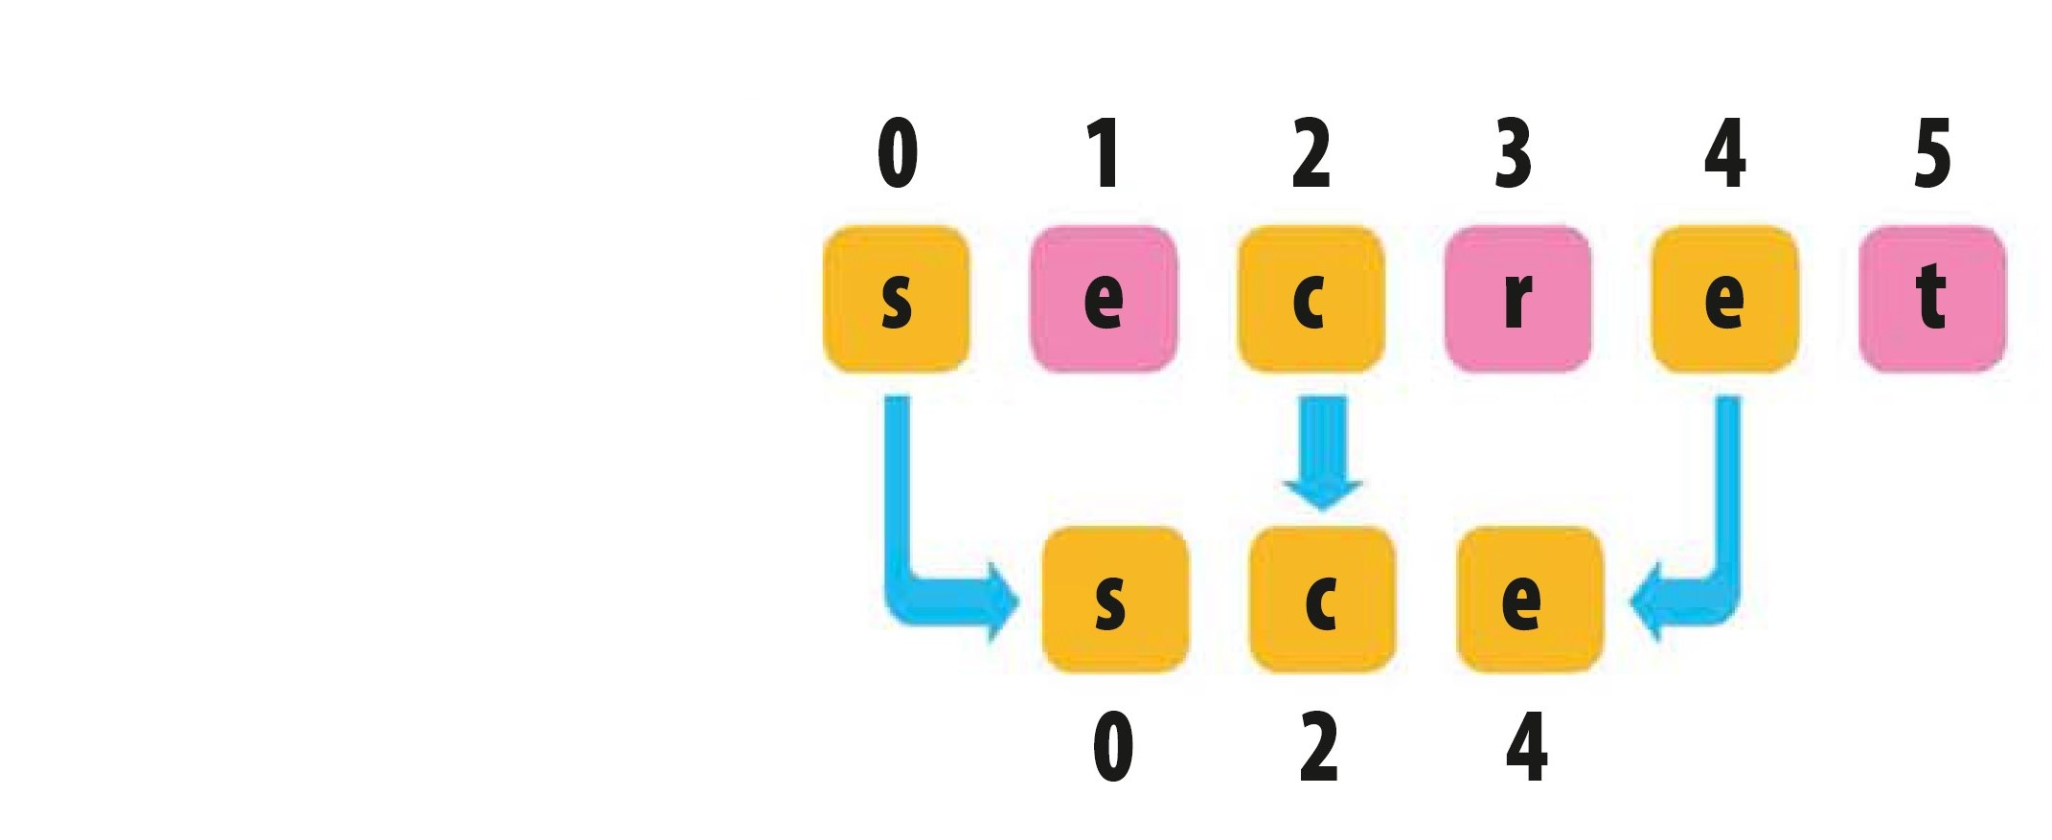
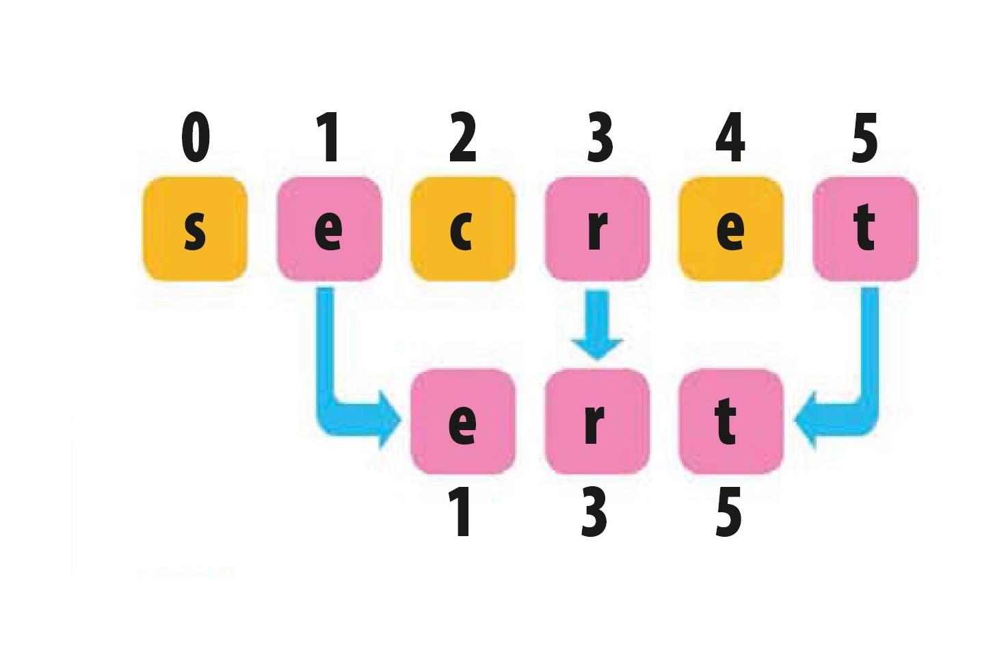
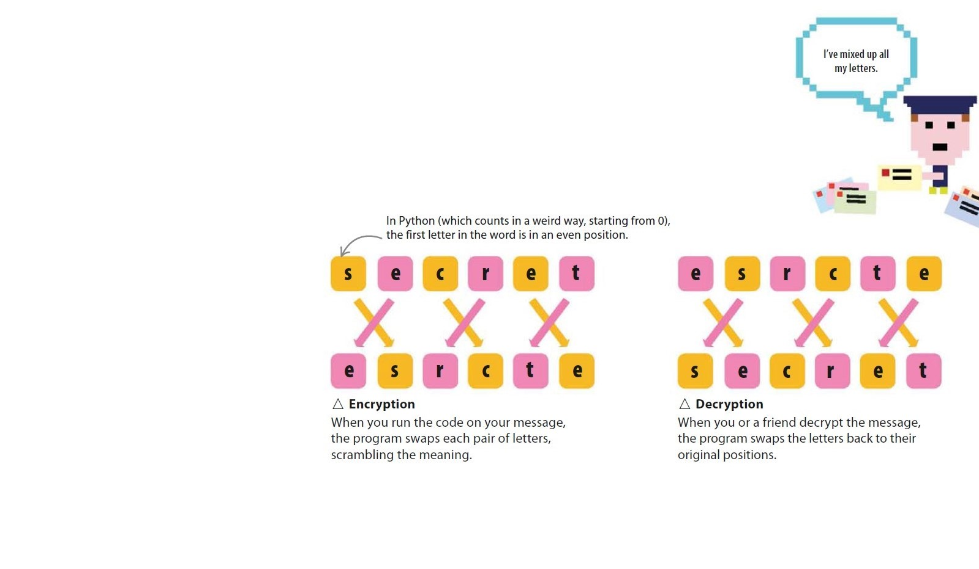
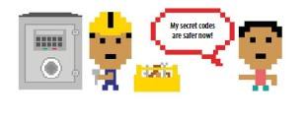
features
1. SWAPPING EVEN POSTION LETTERS WITH ODD POSITION LETTERS AND VICE-VERSA
2. REVERSING THE ENCRPYTED MESSAGE
3. ADDITION OF FAKE LETTERS IN BETWEEN THE ENCRPYTED MESSAGE /CIPHERTEXT
4. CONVERT THE MESSAGE IN CIPHER TEXT USING A PYTHON LIBRARY
5. GENERATATION OF OTP

Slide 17
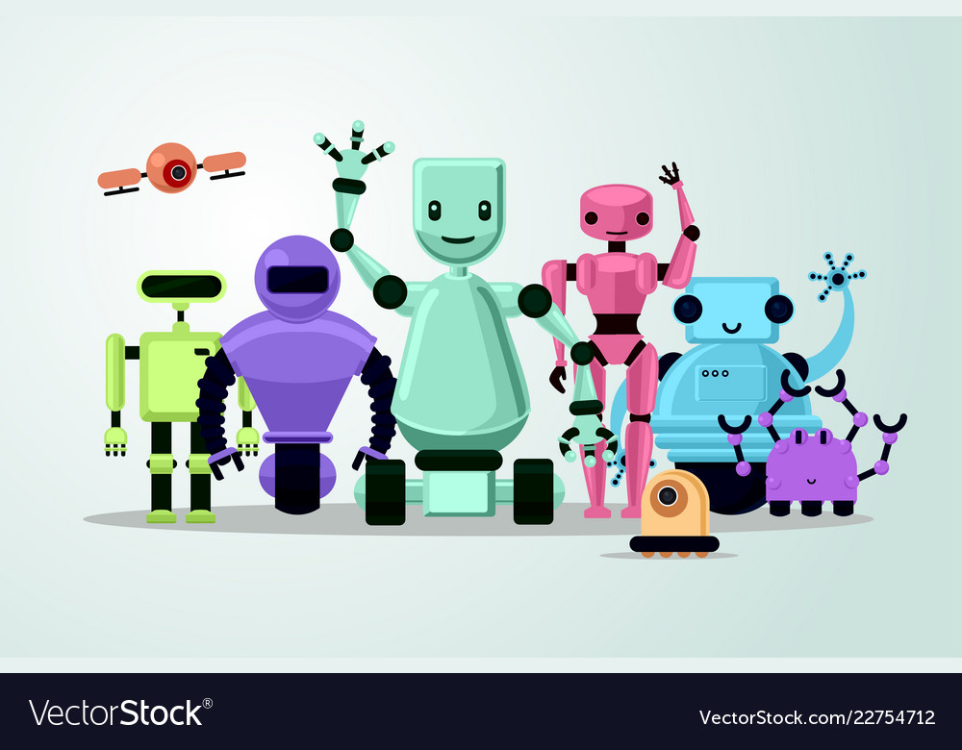
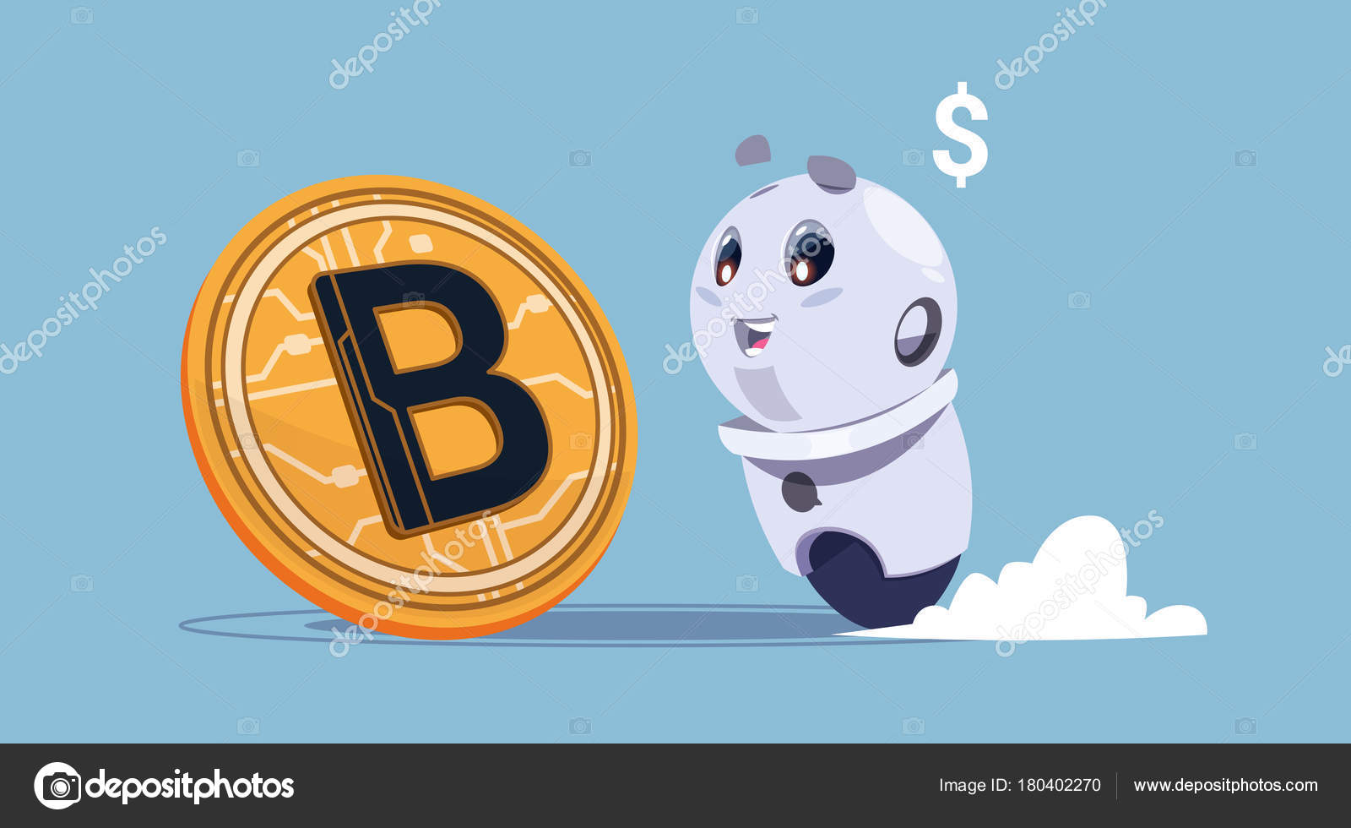
applications
Cryptography is used to encrypt :
Data integrity
Entity authentication
Data origin authentication
Non- repudiation
Encryption of messages

Slide 18
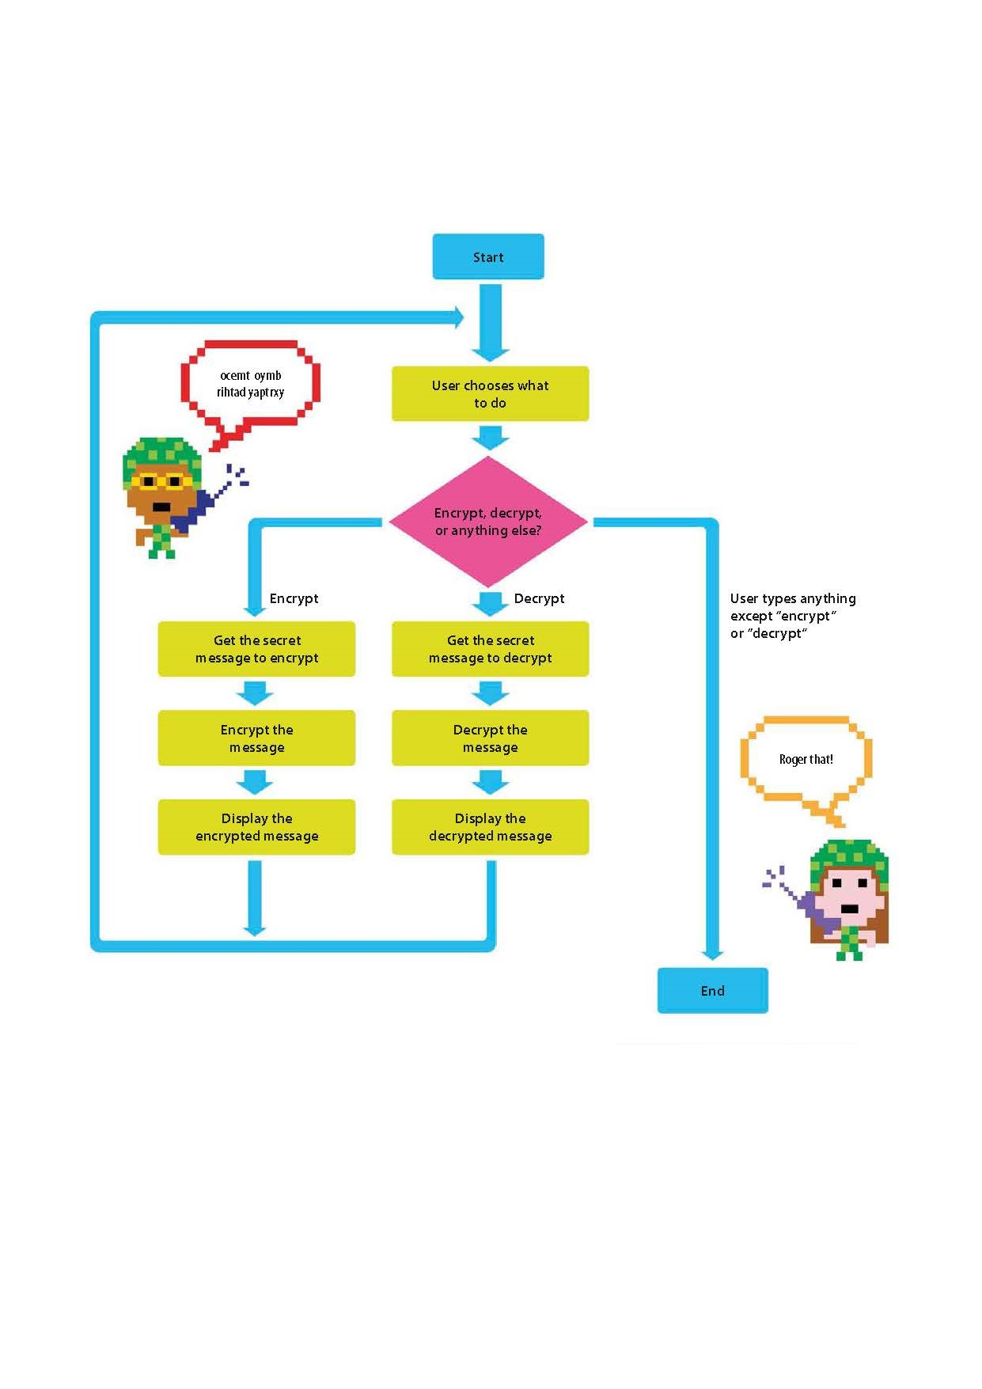
FLOWCHART (basic cryptography process)

Slide 19
ALGORITHM
◁ Secret Messages algorithm :
START
Add modules
Write if else condition for encrypt or decrypt or quit.
Get input from user.(Message)
Define loop
Define even function to check for even no of characters in message
Get the even letters
Get odd letters
Swap the letters round
Add function to join the fake letters in the messsage
Update the loop written in step_5 accordingly
Add functions for encryption of message
Write encrypt code
Write decrypt code
Update the loop in step_5 accordingly
Use the onetimepad lib. to finally encrypt the code
Generate the otp
TERMINATE THE PROGRAM

Slide 20
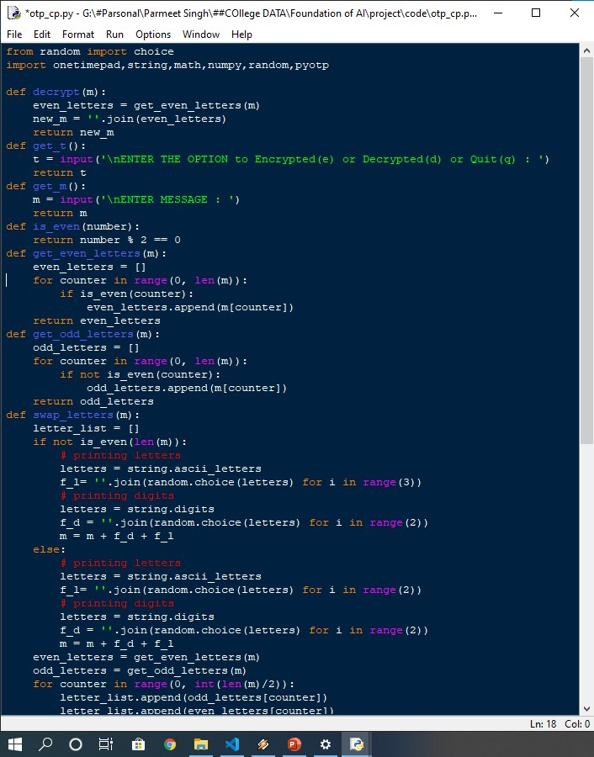
code

Slide 21
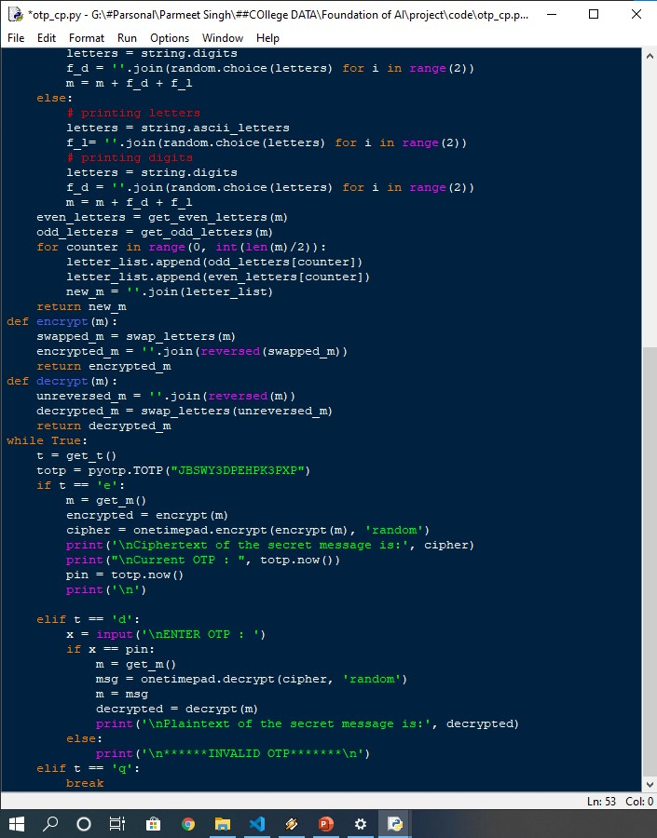
code

Slide 22
Code execution

Slide 23
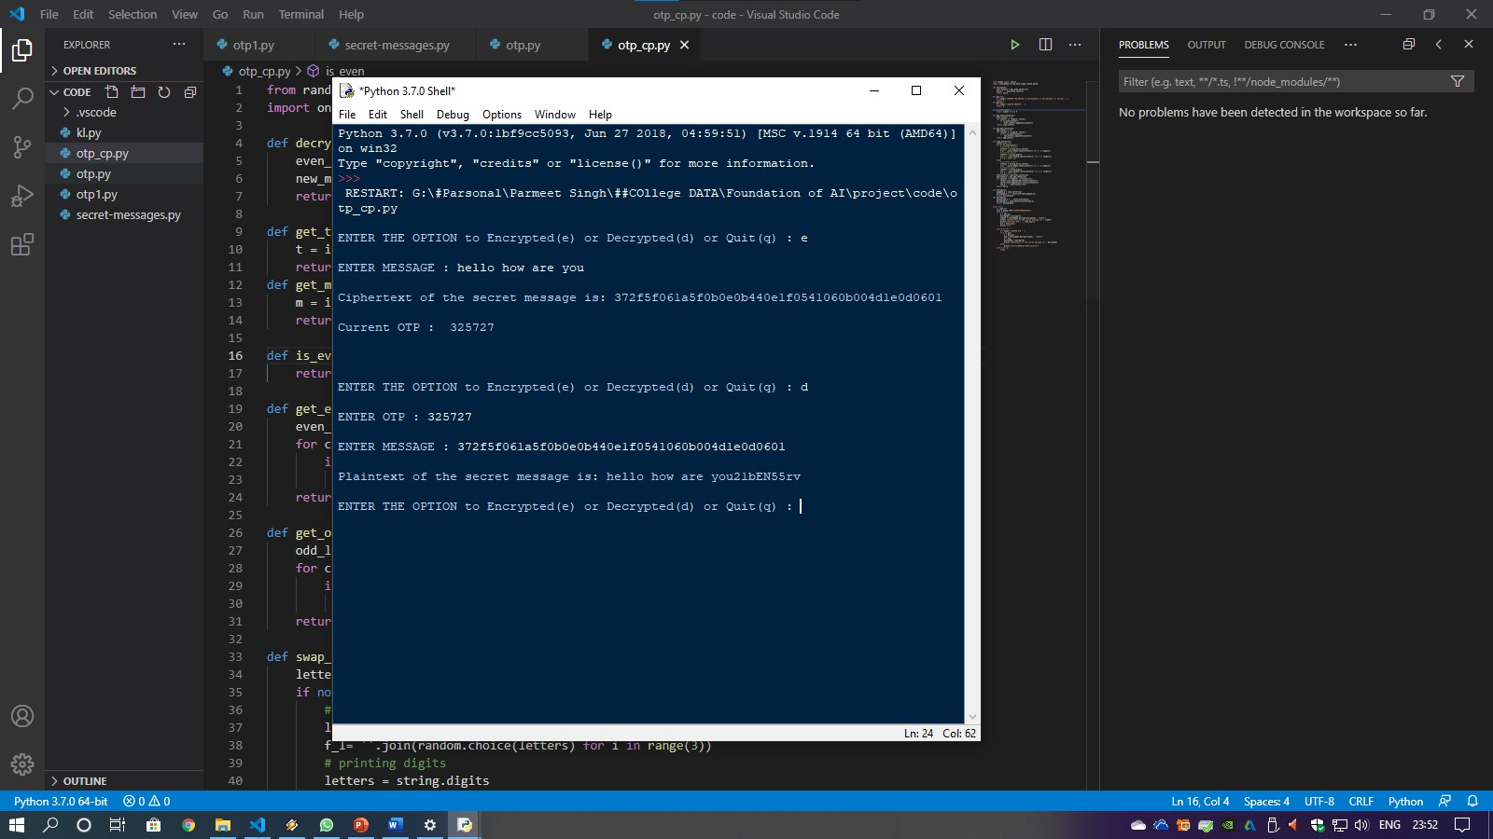

Slide 24
Screen Recording

Slide 25
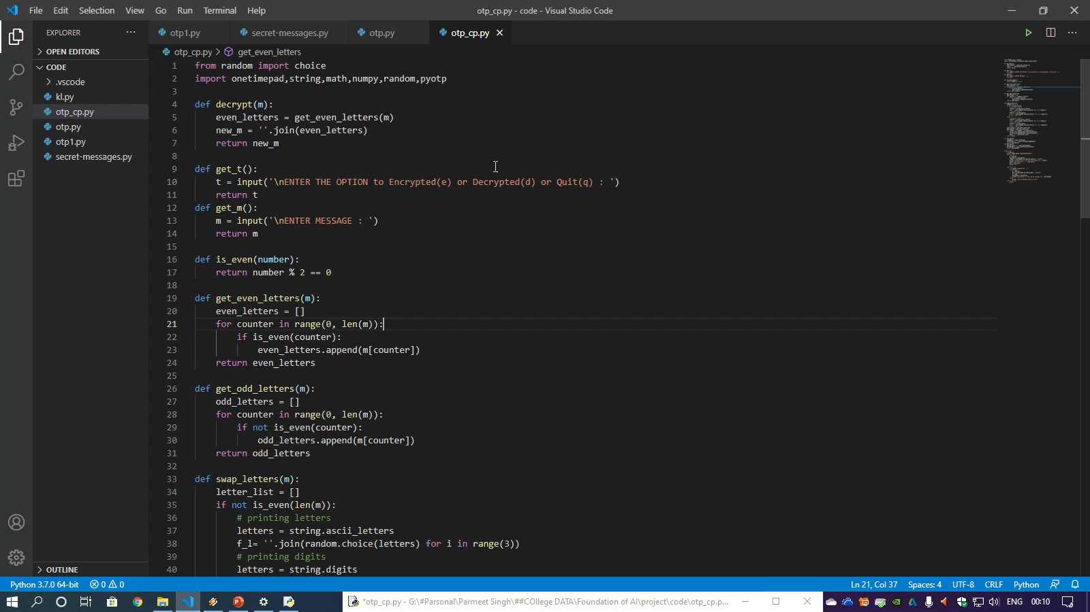

Slide 26

References / Deliverables
https://www.geeksforgeeks.org/cryptography-gui-using-python/
https://www.tutorialspoint.com/cryptography_with_python/index.htm
https://inventwithpython.com/hacking/chapter22.html
https://www.geeksforgeeks.org/python-program-to-generate-one-time-password-otp/#:~:text=They%20are%20generally%20combination%20of,to%20generate%20OTP%20using%20Python.
https://www.youtube.com/watch?v=50XM-h3h6Fw
https://www.youtube.com/watch?v=5jpgMXt1Z9Y
https://pypi.org/
https://github.com/
https://stackoverflow.com/
https://www.geeksforgeeks.org/

Slide 27
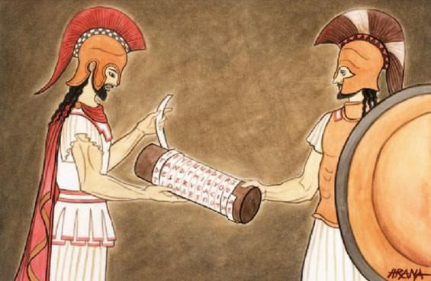
Thank you
GROUP : 3
AKASH (20BCS4388) --- (GRP. REPERSENTATIVE)
PARMEET SINGH (20BCS4415)
HARSH BABU (20BCS4412)
BHARTI MALIK (20BCS4384)
ASHISH KUMAR (20BCS4409)
20IS+BD
SUBJECT CODE -- 20ECP-118_20IS-BD_B
CSE (H) – BIG DATA ANALYITCS
SUBMITTED TO – SUBODH BANSAL

